Slide 1

Steam’s Player Base
What Are They Up Too?
Prepared By:
Anthony Stoneman
Jayden Veno

Slide 2




Introduction
All data reflects Steam and Steam alone, other online store fronts, launchers and consoles not included in the data present in this presentation.

Slide 3
Background
Steam is a video game digital distribution service and storefront developed by Valve Corporation. It was launched as a software client in September 2003 to provide game updates automatically for Valve's games, and expanded to distributing third-party titles in late 2005.
SteamDB(Data Source) tracks a variety of data from historic pricing to player counts, SteamDB Publishes this information on their website, player data is openly available for download by selecting the games you wish to track. Other features of SteamDB that may interest you is an account calculator, that tallies game time, games in your library, the cost you paid for those games and more.

Slide 4
Details
Source Used
(Steam DB) https://steamdb.info (Retrieved CSV for Steam LifeTime, Top Ten Concurrent all time)
Tools Used:
Tableau
Git Bash
Google Slides
Google Docs

Slide 5
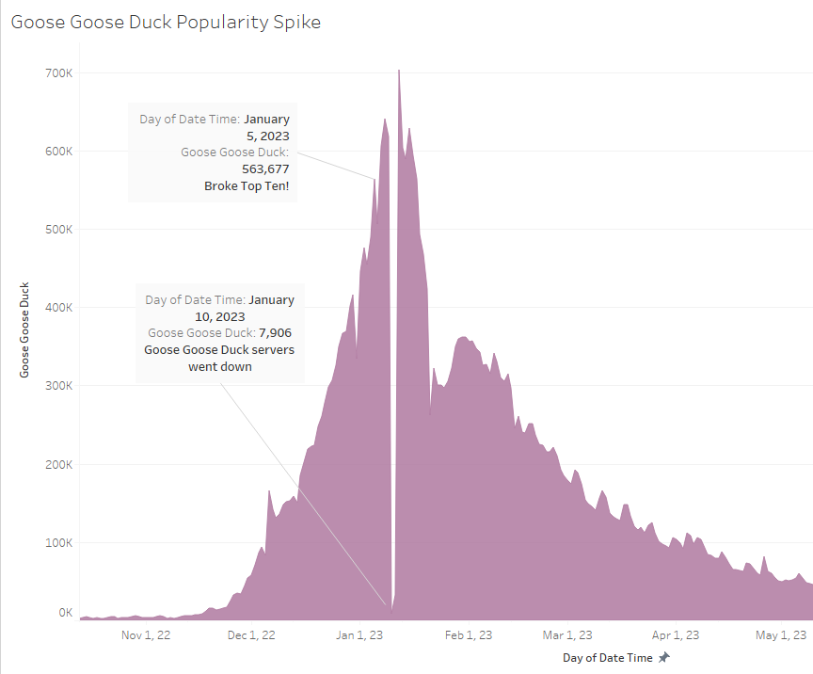
Goose Goose Duck?
What is Goose Goose Duck?
Where did it come from?
Where did it go?

Slide 6
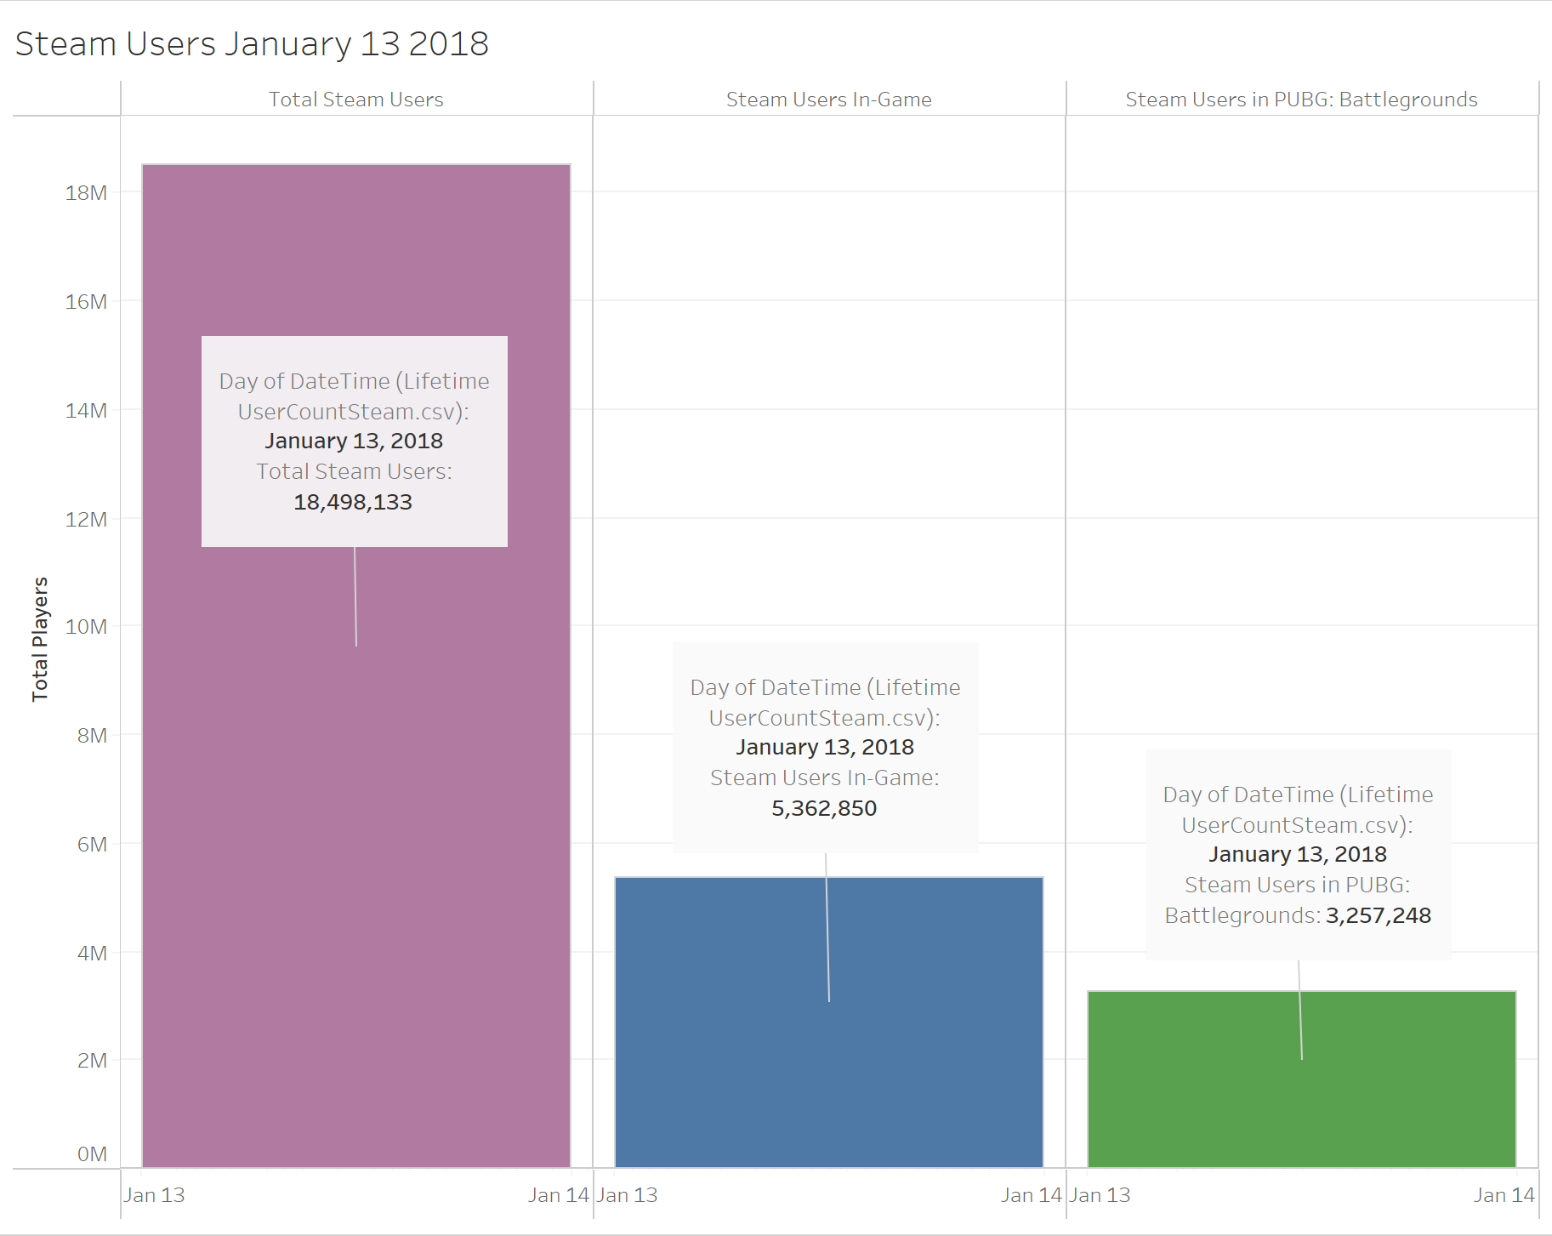

PUBG!
What was the highest concurrent Players game of all time, when did it achieve this, how does it compare to Steam Users and Steam-Users-In-Game?

Slide 7
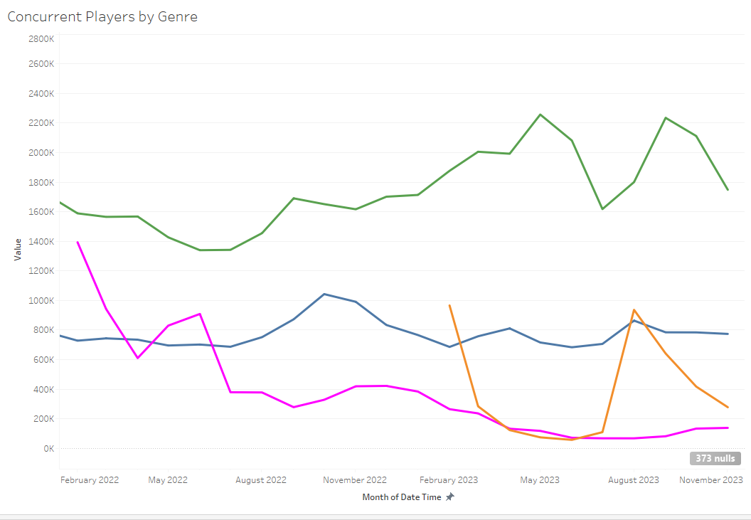
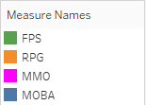
Genres
Is there a common Genre in the top 10?

Slide 8
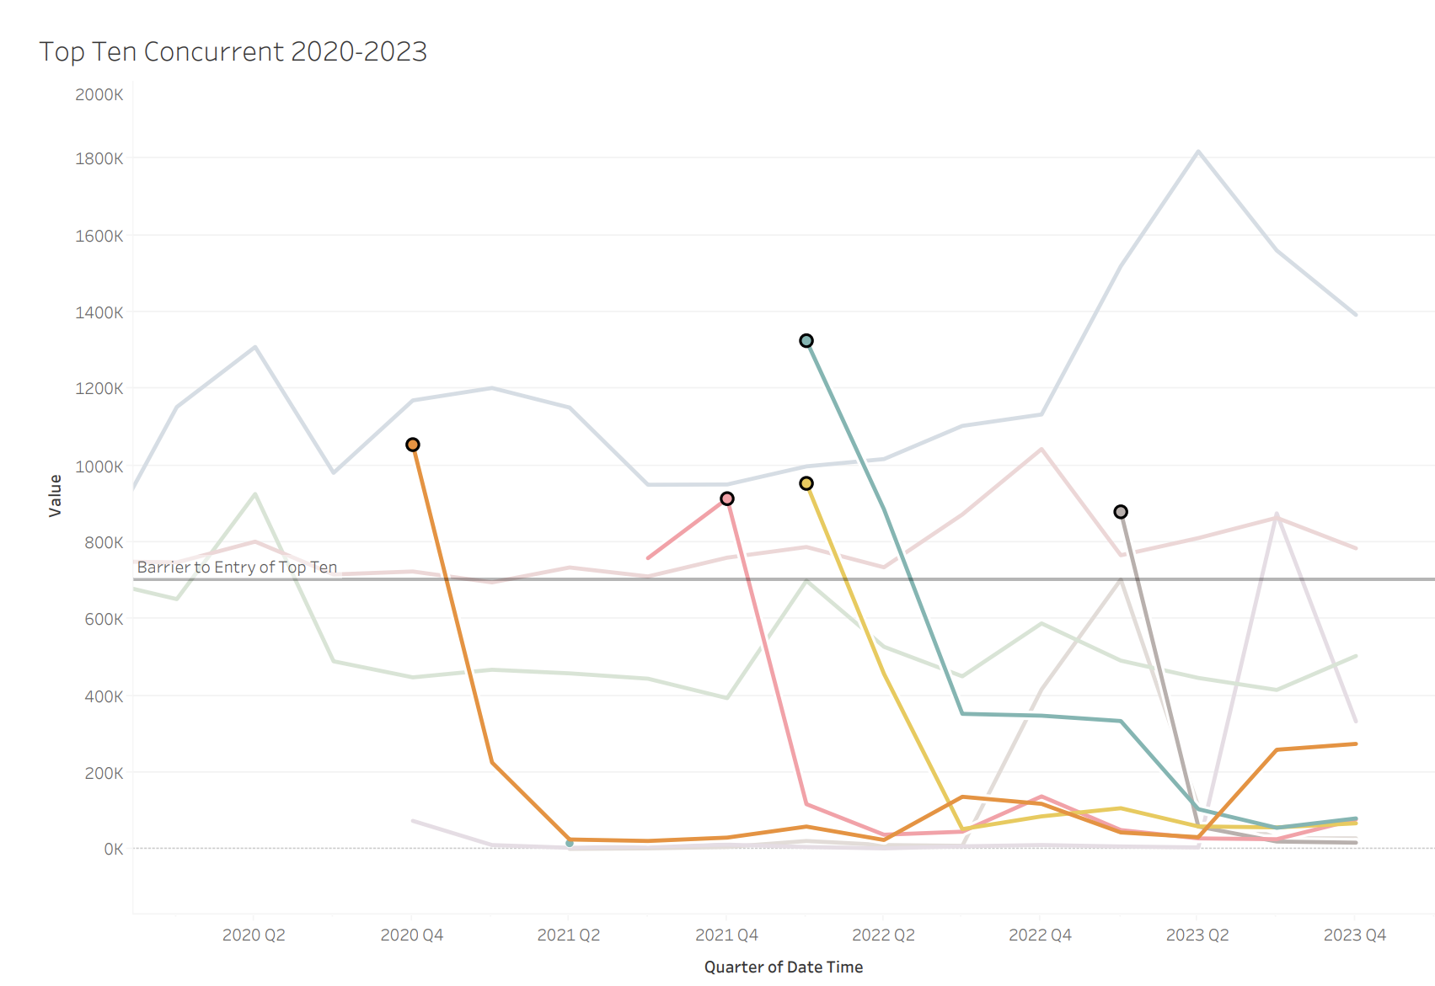
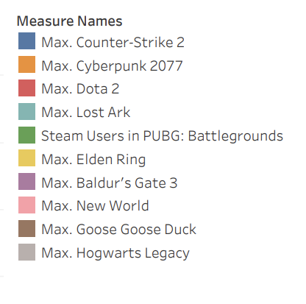
Longevity
Do these games experience long term longevity or a rapid fall off?

Slide 9
Conclusion
-Unveiling "Goose Goose Duck"
-PUBG surprise stats
-Gaming Community Dynamics

Slide 10

Questions
Ask Away!

Slide 11
Resources
(Steam DB) https://steamdb.info (Retirieved CSV for Steam LifeTime, Top Ten Concurrent all time)
Polygon Article https://www.polygon.com/23541058/goose-goose-duck-game-steam-bts-v-kim-tae-hyung

